Slide 1
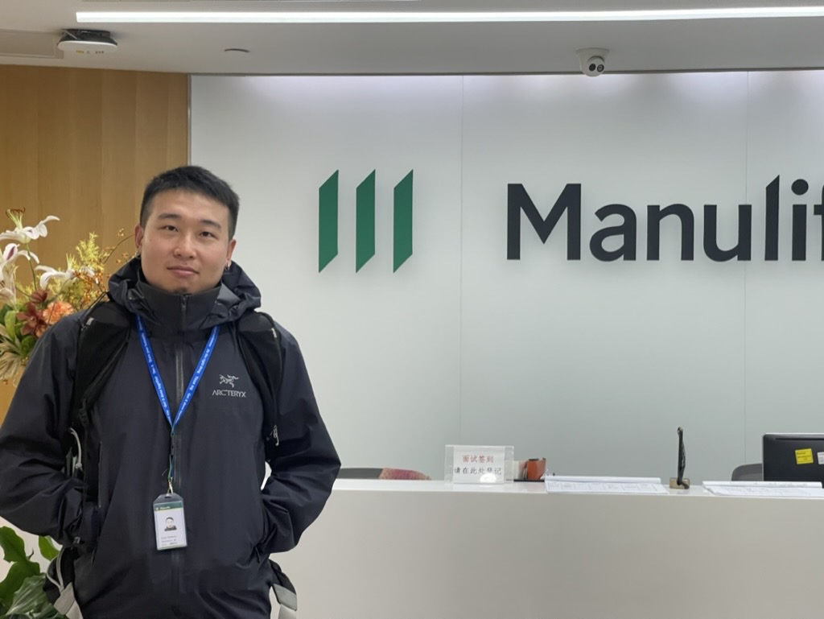
Conestoga Provincial Park Online Reservation System
Team member:
Bin Hu
Responsibility:
Teamlead,
Project owner,
Full-stack Dev,
Client communication,
Github Management

Slide 2
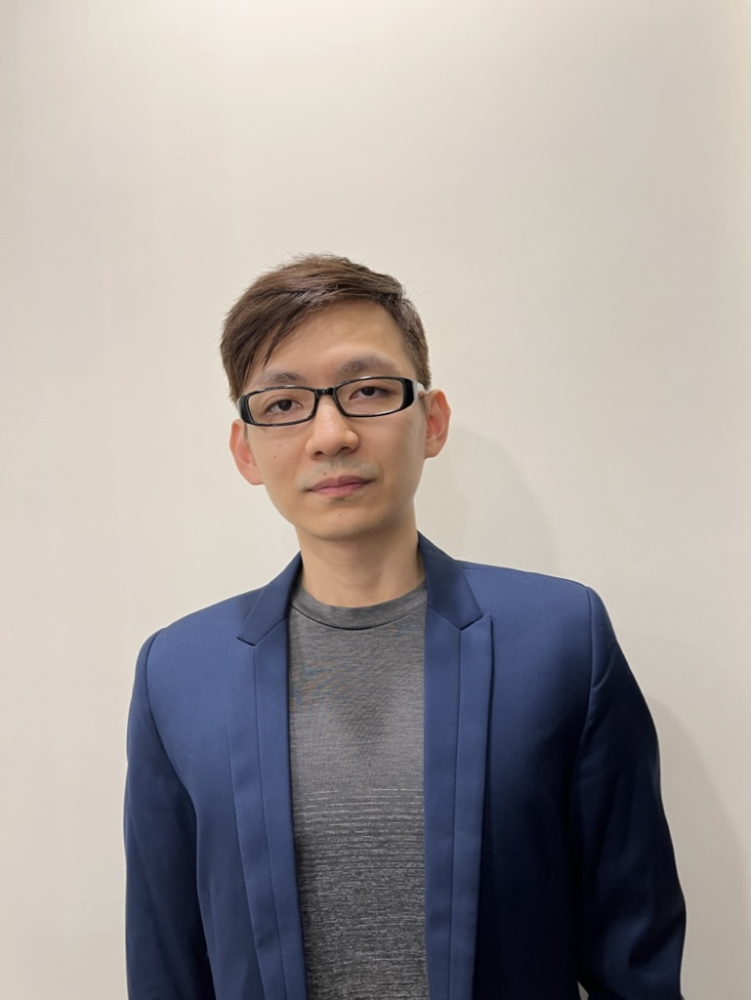
Conestoga Provincial Park Online Reservation System
Team member:
Chia-Hua Chang
Responsibility:
Project cloud deployment,
Front-end design and dev,
Meeting munites and documentation,
Jira management,
Scrum master

Slide 3
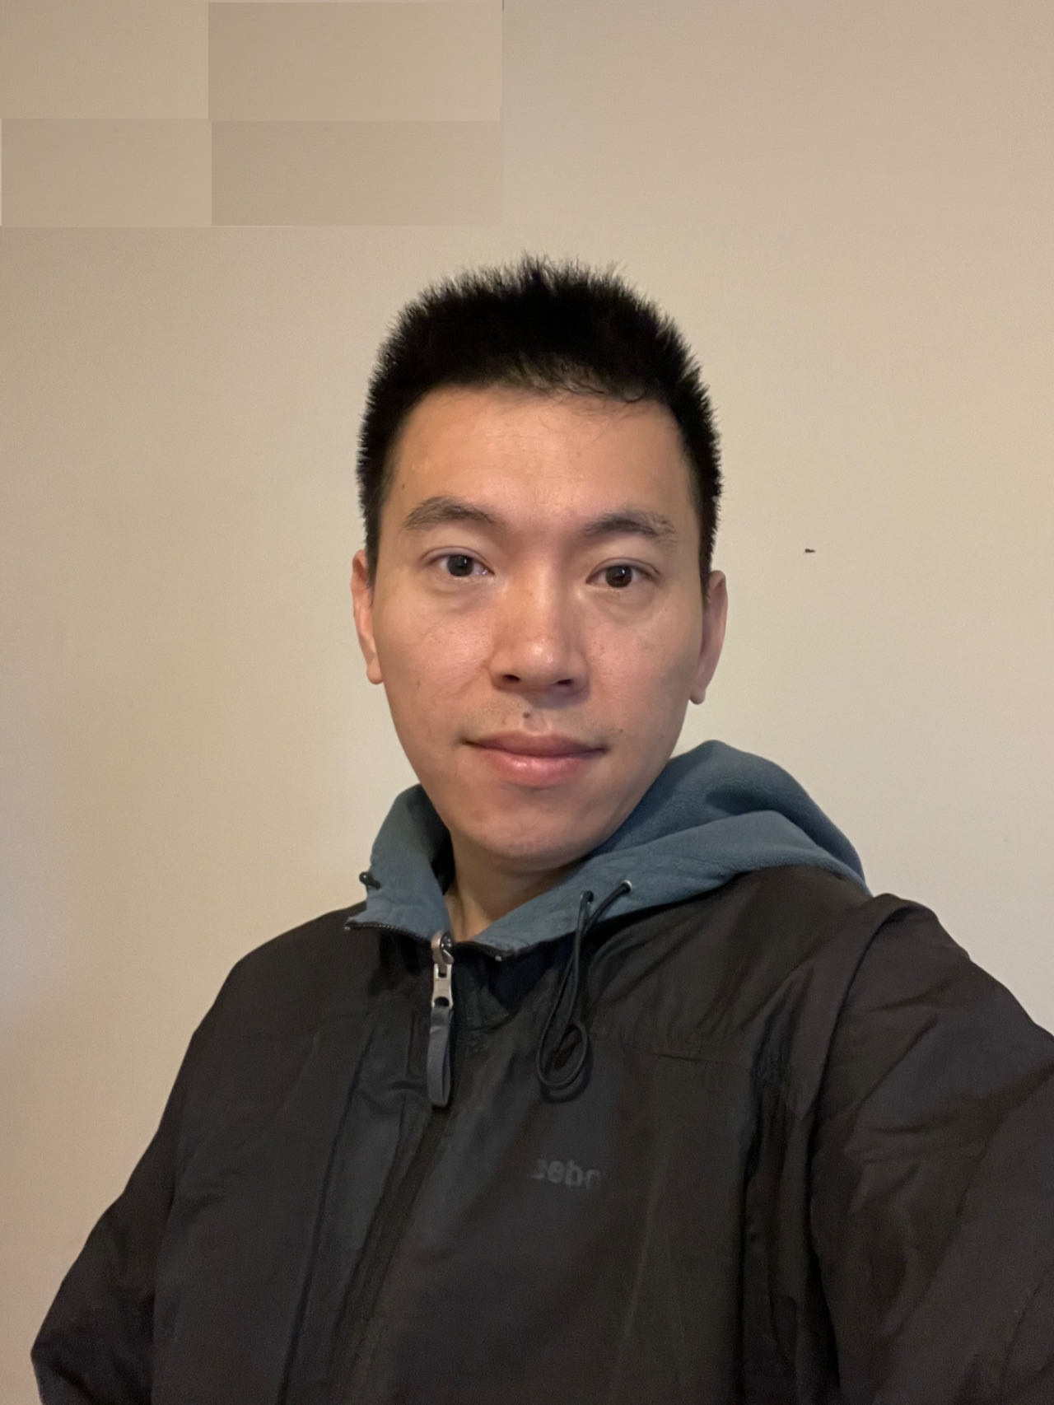
Conestoga Provincial Park Online Reservation System
Team member:
Zhiqun Xie
Responsibility:
Full-stack Dev,
Powerpoint，
Support

Slide 4
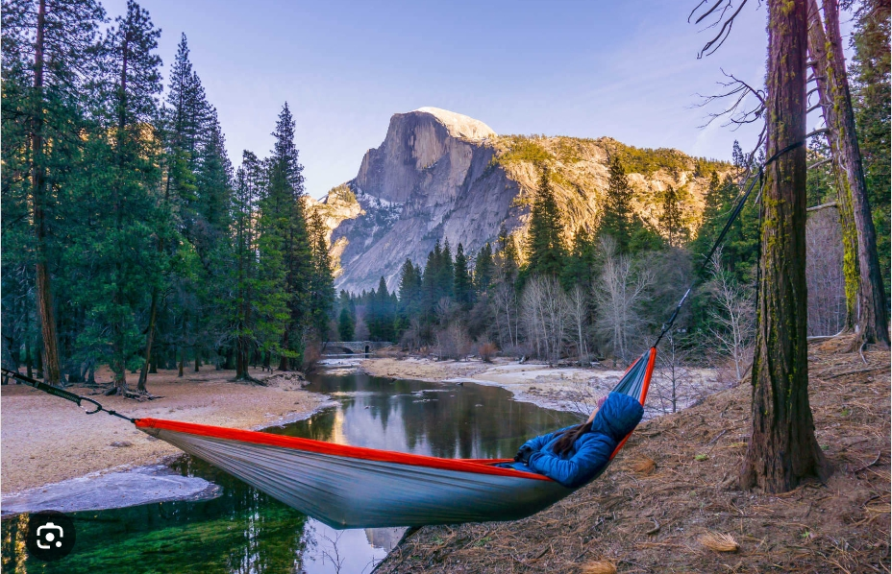

Conestoga Provincial Park Online Reservation System
Client company:
Conestoga Provincial Park
P.I.C : Mr. Thomas Hanks
Position: CEO

Slide 5
Thank you!
TO BE CONTINUED.
- subject to change
To add in future updates:
- biz purpose
- teck stack
- system design diagrams

